Slide 1


Reporting in Salesforce
Deloitte Consulting LLP
Date: 02-Feb-2015

Slide 2
Contents
Introduction Report Formats Navigating in Report Tab Custom Reports and Report Builder Reporting Best Practices Reporting Charts Dashboards

Slide 3
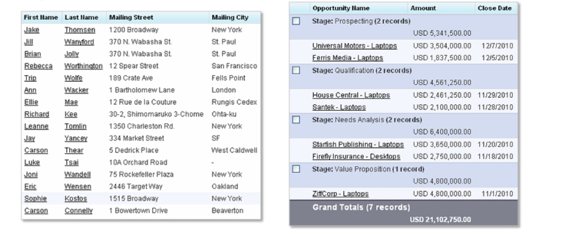
Introduction
What are Reports?
Reports are lists or summaries that allow you to aggregate and analyze your data in different ways

Slide 4
Introduction
Predefined versus Custom Reports
Predefined Reports
Custom Reports
Have been created for you, by your local administrator
Can be found in public folders
Can be further customized
Cannot be overwritten or deleted
Can be built from scratch
Can be created based on predefined reports
Must be saved in your personal folder, or can be stored by your local admin in a public folder (to become a predefined report)
Can be overwritten and deleted

Slide 5
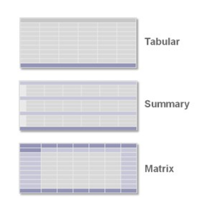
Report Formats
Three report formats exist:
Tabular report
Summary report
Matrix report

Slide 6
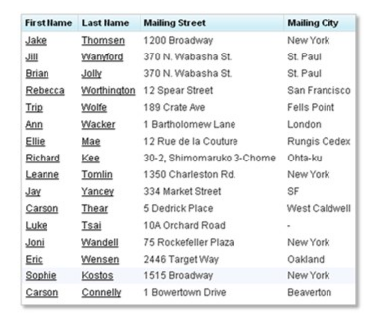
Report Formats
Tabular Reports
A tabular report is a simple list of records with columns and rows
Tabular reports do not support the creation of groupings or summaries
Only tabular reports can have floating headers to facilitate scrolling
Examples:
A contact mailing list
An open activity report

Slide 7
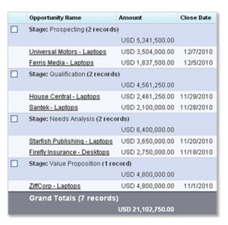
Report Formats
Summary Report
A summary report is a list of records that can be grouped and summarized
Summary reports allow grouping of fields
Summary reports allow calculations on summary fields
Summary reports can have charts
Examples:
A report showing all opportunities, subtotaled by Stage and Owner
A report of converted leads by division

Slide 8
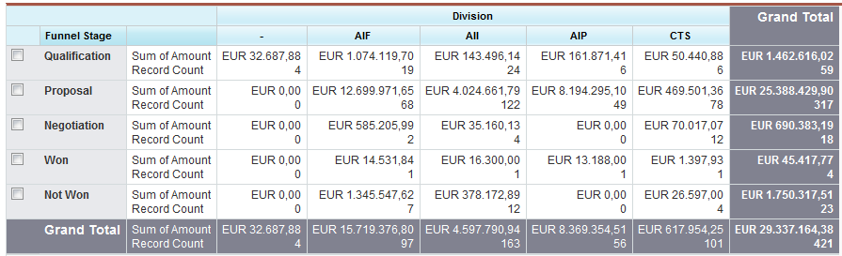
Report Formats
Matrix Report
A matrix report summarizes data in a grid.
Matrix reports allow grouping of fields in two or more dimensions
Matrix reports can be used to compare related totals
Matrix reports can have charts
Examples:
Account revenue by owner and type
Opportunity amount by stage and division

Slide 9
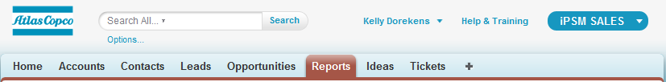
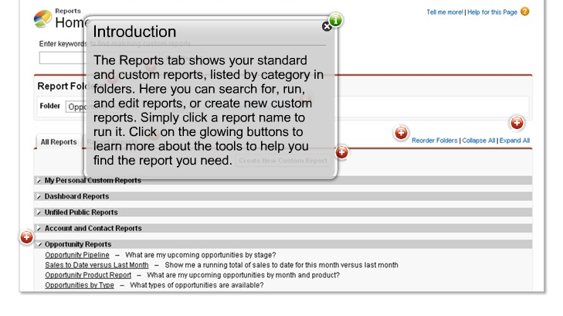
Navigating in Report Tab
Navigating the Reports Tab

Slide 10
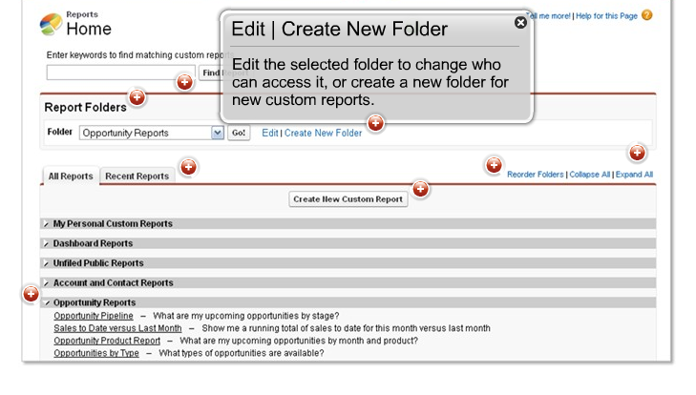
Navigating in Report Tab
Edit a folder or create a new folder
Global Admins can edit the selected folder to change who can access it, or create a new folder.

Slide 11
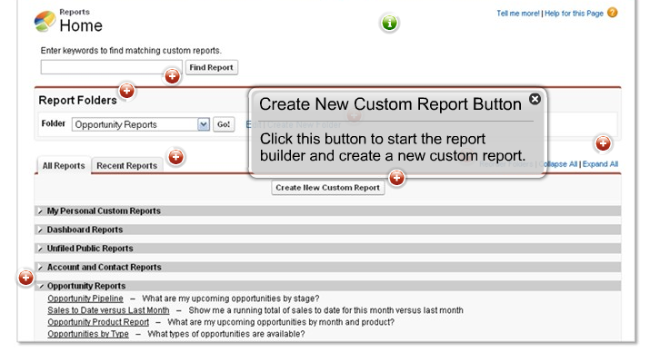
Navigating in Report Tab
Create new custom report

Slide 12
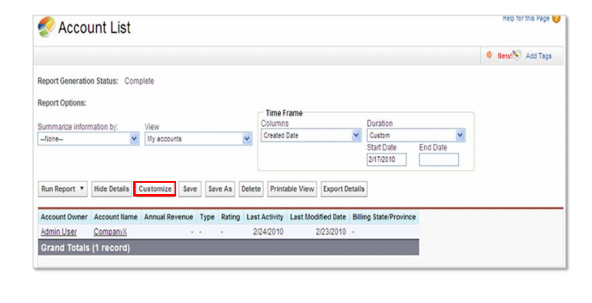
Creating Custom Reports & Report Builder
Customized reports can be created and modified in the report builder.
Access the report builder via the customize button on a predefined report or by clicking the create new custom report button on the reports tab.
The report builder allows you to:
Select columns to display
Re-order the columns
Set specific criteria
Create groupings or summaries
Add a chart to your report

Slide 13
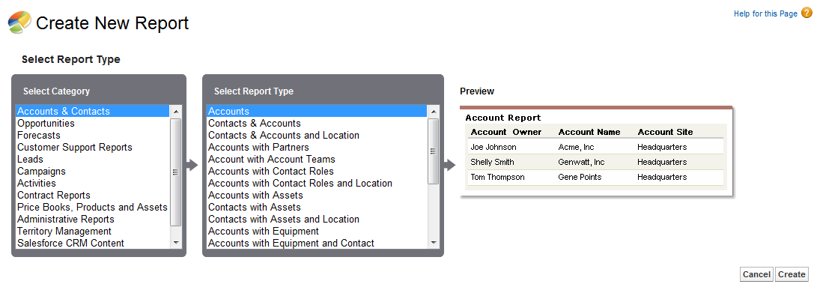
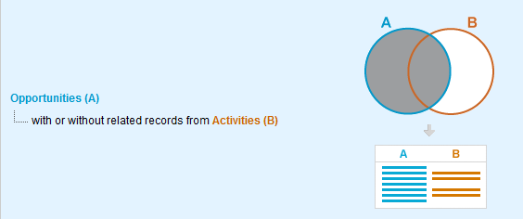
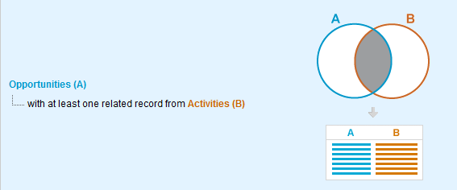
Creating Custom Reports & Report Builder
Reports display only records that meet the criteria defined in the report type.
Examples:

Slide 14
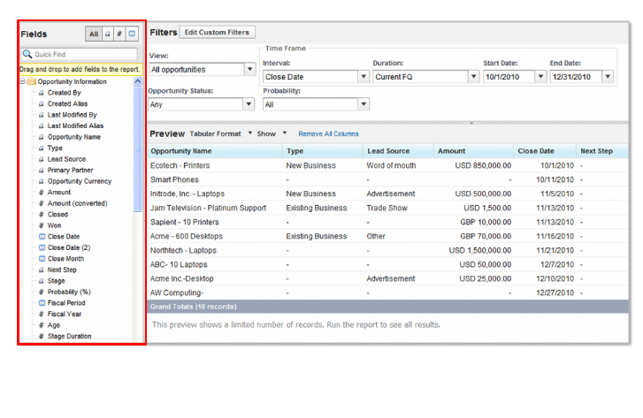
Creating Custom Reports & Report Builder
The report builder (1/3)
The fields pane lists all accessible fields in the selected report type. Drag a field into the preview pane to add it to your report.

Slide 15
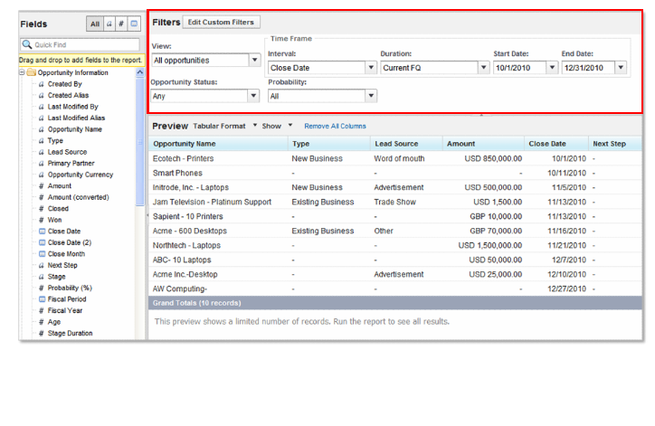
Creating Custom Reports & Report Builder
The report builder (2/3)
The filters pane allows you to specify the view and time frame that you want to set for your report. You can also add custom filters to your report to limit the data returned by the report.

Slide 16
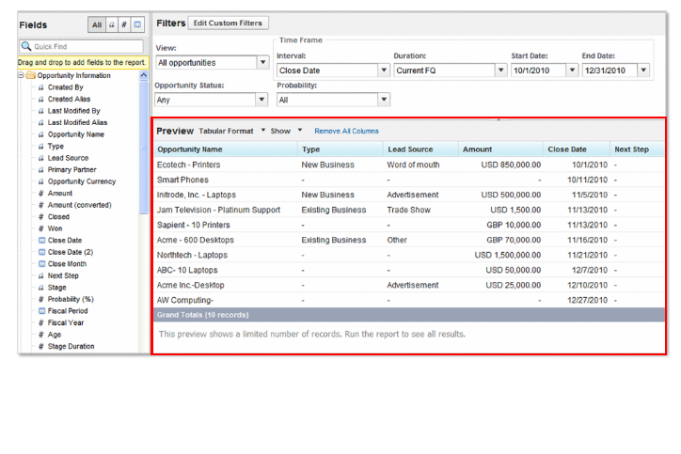
Creating Custom Reports & Report Builder
The report builder (3/3)
The preview pane contains a dynamic report preview, which allows you to customize your report and see the immediate effect. Here you can easily add, reorder, and remove columns, summary fields, formulas, charts and groupings.

Slide 17
Reporting Best Practices
Some key best practices when creating and modifying reports include:
Use a predefined report as a starting point when possible
Understand the difference between Save and Save As
Use report folders in a consistent way to provide access to reports
Use consistent naming conventions for reports
Use relative date ranges and special date values to keep your reports relevant. Examples include today, yesterday, current FY and last 30 days

Slide 18
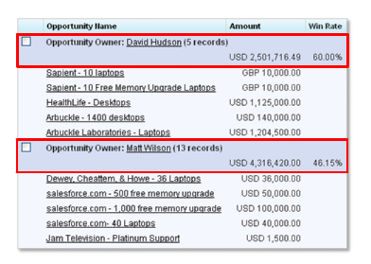
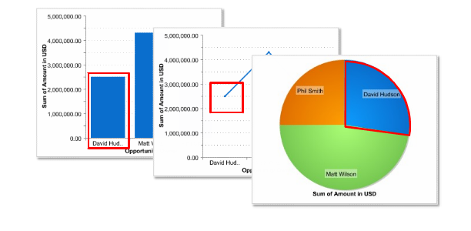
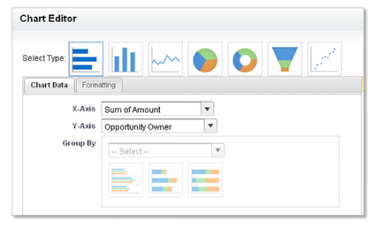
Reporting Charts
Charts are used to visually present the data in the summary rows of your report

Slide 19
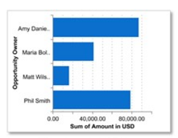
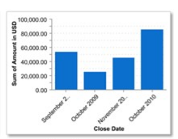
Reporting Charts
Bar Charts
On a bar chart, each bar represents data from a grouping
Horizontal bar charts are used to compare many groups
Vertical bar charts are used to compare fewer groups or when grouping by a date field

Slide 20
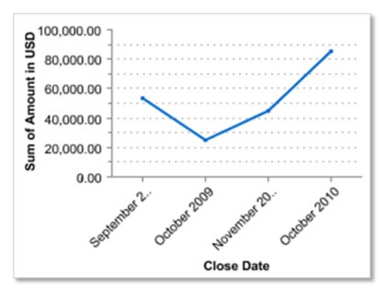
Reporting Charts
Line Charts
On a line chart, each point represents data from a grouping
Line charts are typically used when grouping by a date field and displaying changes over time

Slide 21
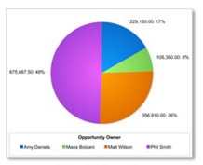
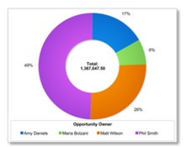
Reporting Charts
Pie Charts and Donut Charts
On a pie or donut chart each wedge represents data from a grouping
Pie charts are typically used to compare different shared in a grand total
Donut charts have the same functionality, but can also display the grand total in the center of the chart

Slide 22
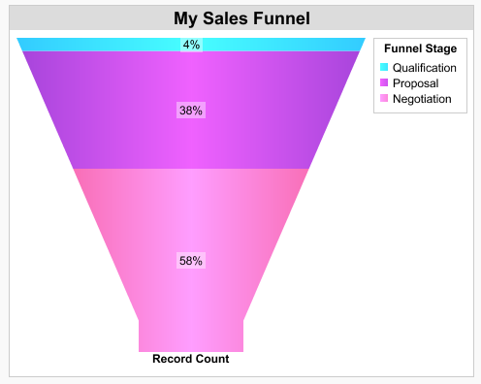
Reporting Charts
Funnel Charts
On a funnel chart each segment represents data from a grouping
Funnel charts are typically used to show proportions among groupings in an ordered set

Slide 23
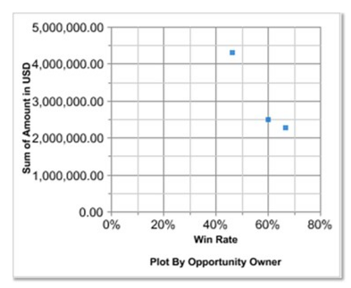
Reporting Charts
Scatter Charts
A scatter chart plots two summary fields against one another to visualize the correlation between values for a particular grouping
Example: You can use a scatter chart to analyze the correlation between the value of closed won opportunities for salespersons and their win rate, to see if salespersons handling more opportunities are more or less successful than salespersons handling fewer

Slide 24

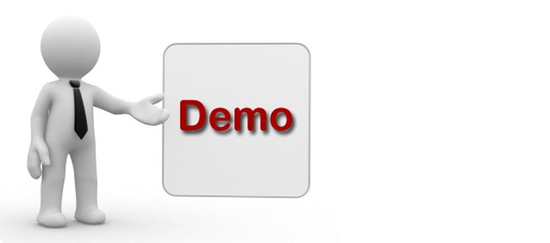
Reporting Charts - Demo

Slide 25
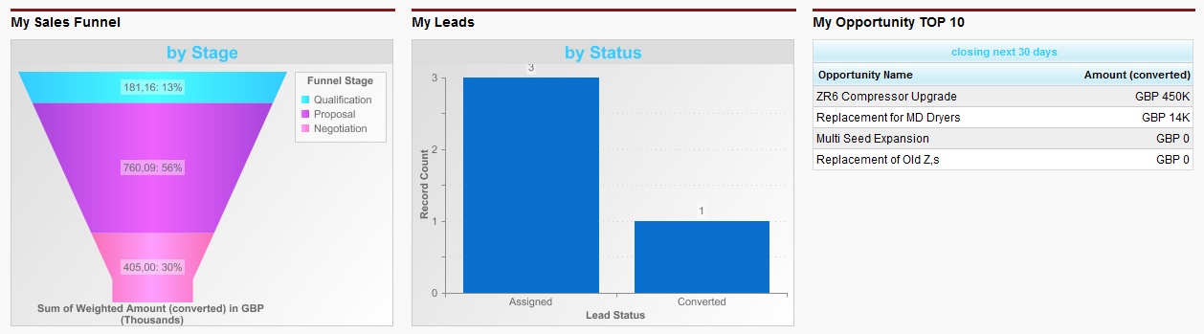
Dashboard
What is a dashboard?
A dashboard is a visual representation of key business information through a group of charts
Dashboards:
Combine summary data from multiple reports
Are real time snapshots of metrics and Key Performance Indicators

Slide 26
Dashboard
Dashboard Basics
All users can view dashboards, since all profiles have been granted the “Run Reports” permission
Users can only run dashboards which are stored in folders they can access
Global administrators can provide folder access or create new folders
High level (summary) data is visible on a dashboard
While setting up a dashboard you can indicate a ‘running user’
The data visible on the dashboard will be the data visible to this running user
A small set of dashboards can be created to reflect the data for the logged in user (e.g. The home page dashboards)
Dashboards need to be refreshed to show the most current data
Users can manually refresh a dashboard
Global administrators can schedule limited automatic dashboard refreshes

Slide 27
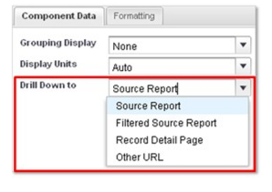
Dashboard
What other data can users access from a dashboard?
From a dashboard, users can drill down to:
The source report
A filtered source report when clicking on charts
A record detail page from charts and tables
A specified URL
A specified URL is a great way to lead users to another related dashboard or report

Slide 28
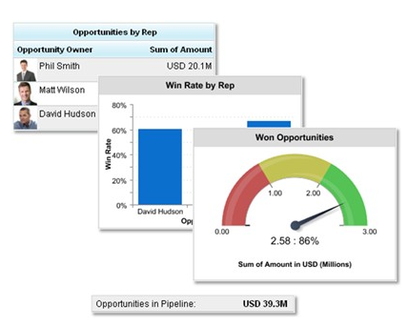
Dashboard Components
Each dashboard consists of several components (up to 20 per dashboard)
Components can be charts, tables, metrics and gauges

Slide 29
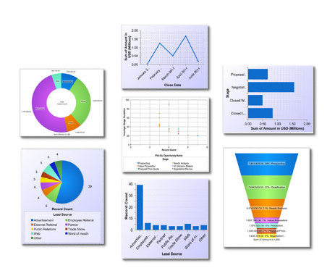
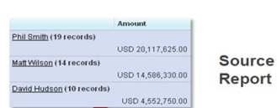
Dashboard Components
Charts
Charts graphically represent report data from summary rows
Charts:
Derive their values and labels from the source report
Can be newly created for a dashboard or reused from the source report

Slide 30
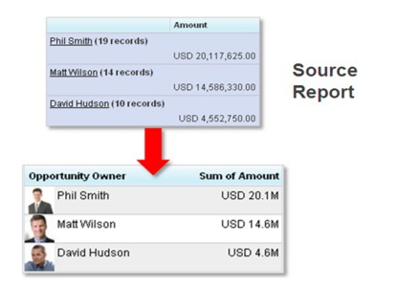
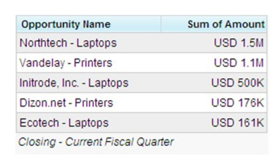
Dashboard Components
Tables
Tables list the top or bottom results from a report
Each row can display the data from a summary row or can display the actual records
Chatter photos can be displayed when the source report is grouped by a user or Chatter Group name
Because you can sort the rows by value, table components are great for creating leader boards

Slide 31
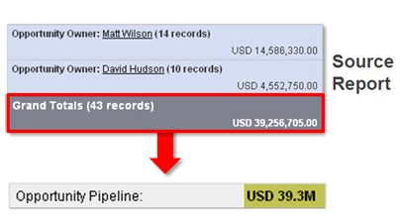
Dashboard Components
Metrics
A metric is a single data value that reflects the grand total of the source report
Metrics are used for displaying key business performance indicators
Metrics can be set up with conditional highlighting

Slide 32
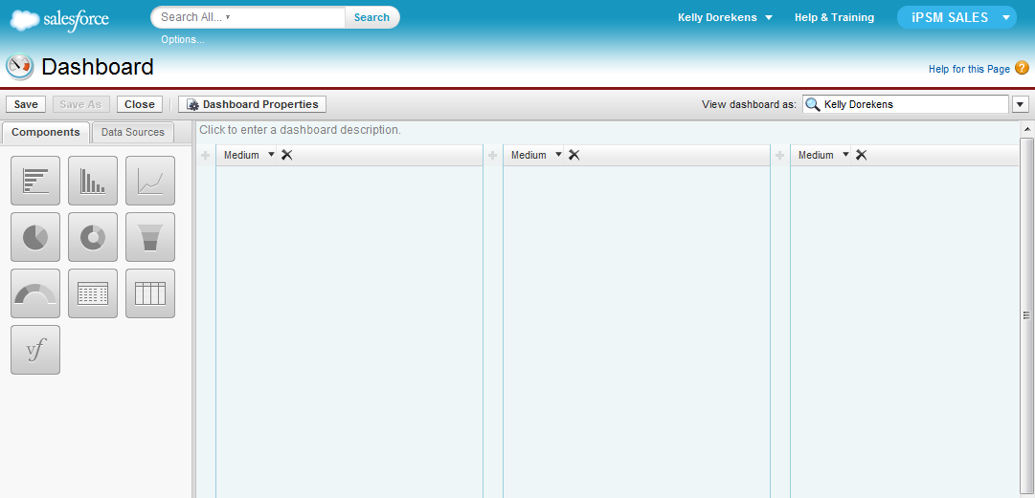
Creating Dashboard
The dashboard builder
The dashboard builder is a drag-and-drop tool for creating new dashboards or modifying existing ones

Slide 33
Q n A

Slide 34


Copyright © 2011 Deloitte Development LLC. All rights reserved.

